Slide 2
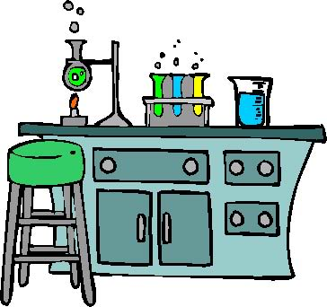
Science Practices
Laboratory Exercises

Slide 3
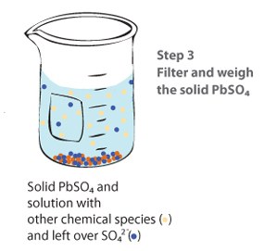
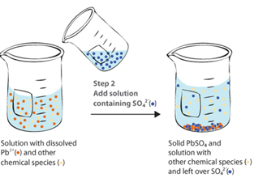
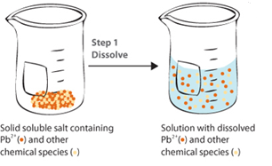
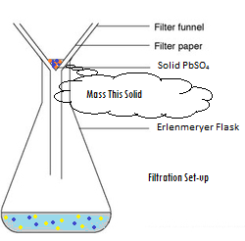
Gravimetric Analysis
Source
What It Determines:
amount of analyte by mass measurements
% composition
empirical formulas
How It Can Be Done:
Dehydration of a hydrate
Forming a precipitate, which is then isolated and massed
Analysis:
Remember to ALWAYS go to moles!
use mole ratios to convert between various components
Video
Virtual Lab
Possible Source of Error | Contamination in solid | Incomplete Precipitation | Solid not fully dehydrated
Impact on Results | measured mass too large | Lose ion in filtrate – mass too small | measured mass too large
Science Practices
1.5 The student can re-express key elements of natural phenomena across multiple representations in the domain.
2.2 The student can apply mathematical routines to quantities that describe natural phenomena.
4.2 The student can design a plan for collecting data to answer a particular scientific question.
5.1 The student can analyze data to identify patterns or relationships.
6.1 The student can justify claims with evidence.
Learning Objectives
1.3: The student is able to select and apply mathematical relationships to mass data in order to justify a claim regarding the identity and/or estimated purity of a substance.
1.17: The student is able to express the law of conservation of mass quantitatively and qualitatively using symbolic representations and particulate drawings.
1.19: The student can design, and/or interpret data from, an experiment that uses gravimetric analysis to determine the concentration of an analyte in a solution.

Slide 4
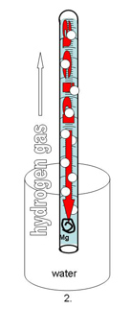
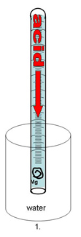
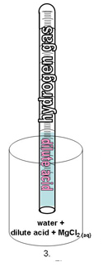
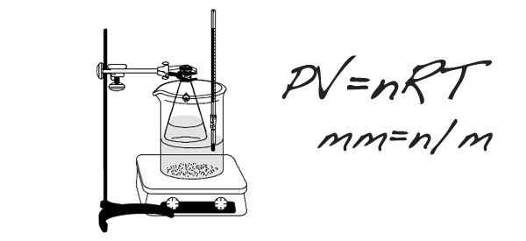
Gas Laws Labs
After rxn, eudiometer lowered into water until levels equal so pressure inside room and tube are same
Use Dalton’s Law to subtract P_{water}
Sources of error:
Mg left: moles of H₂ too low
Air bubble at start: volume of gas too high
Source 1
Determination of Molar Mass of a Volatile Liquid
How It’s Done/Analysis:
Volatile liquid heated until completely vaporized
PV=nRT to solve for n:
Temperature of water bath=T
Small hole in stopper means Pressure = room pressure
Volume=volume of flask
Divide Mass of recondensed unknown by moles, compare to known molar mass to ID unknown
Assume vapor completely recondenses
→If lose vapor, then mass would be too low, and moles would be low
Determination of Molar Volume of a Gas
Source 2
Video 1
Video 2
Video 3
http://chemskills.com/?q=ideal_gas_law
Diffusion : Graham’s Law
Demo
How It’s Done/Analysis:
Ends of glass tube plugged with soaked cotton
White ring is NH₄Cl ppt
Ppt will not be exactly in middle…
Molar mass of NH₃ is lower than MM of HCl, so ring will be toward right side of tube
Graham’s Law can be used to establish ratios which can be applied to distances
Science Practices
1.4 The student can use representations and models to analyze situations or solve problems qualitatively and quantitatively.
2.2 The student can apply mathematical routines to quantities that describe natural phenomena.
2.3 The student can estimate numerically quantities that describe natural phenomena.
6.4 The student can make claims and predictions about natural phenomena based on scientific theories and models.
Learning Objectives
LO 2.4: The student is able to use KMT and concepts of intermolecular forces to make predictions about the macroscopic properties of gases, including both ideal and nonideal behaviors.
LO 2.6: The student can apply mathematical relationships or estimation to determine macroscopic variables for ideal gases.

Slide 5
Chromatography
Click here to watch animation explaining column chromatography
Source
Video
Virtual Lab
Source (includes nice discussion of biological applications)
Main Error:
Incomplete Separation
Can be caused by:
Inconsistent spotting
Overloading
Improper packing (column)
Poor solvent choice
Advantage: We can collect and use the fractions
Science Practices
4.2 The student can design a plan for collecting data to answer a particular scientific question.
5.1The student can analyze data to identify patterns or relationships.
6.2 The student can construct explanations of phenomena based on evidence produced through scientific practices.
Learning Objectives
LO 2.7: The student is able to explain how solutes can be separated by chromatography based on intermolecular interactions.
LO 2.10: The student can design and/or interpret the results of a separation experiment (filtration, paper chromatography, column chromatography, or distillation) in terms of the relative strength of interactions among and between the components.

Slide 6
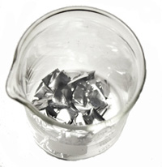
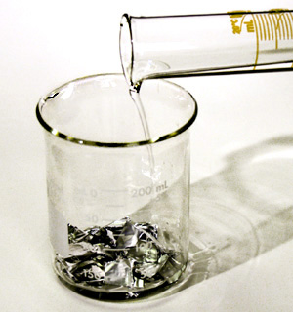
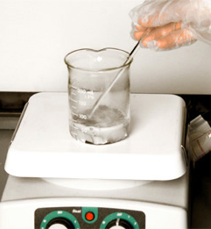
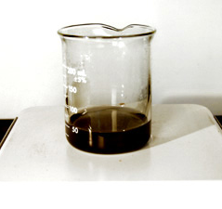
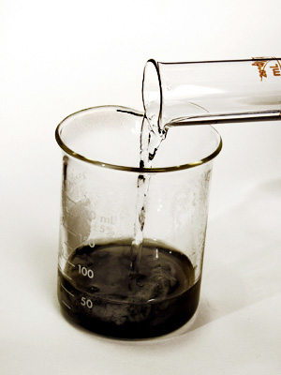
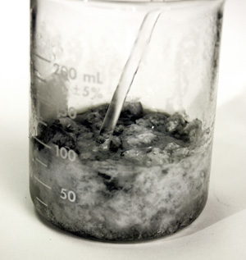
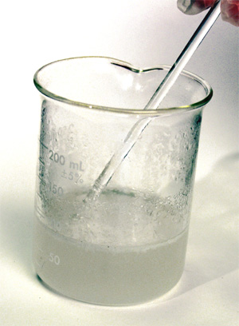
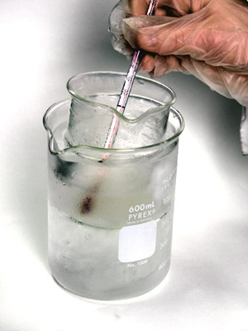
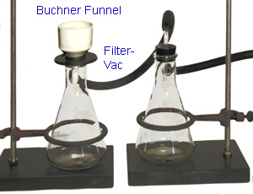
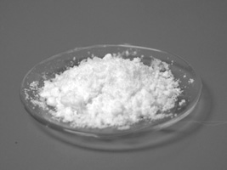
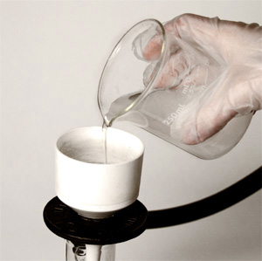
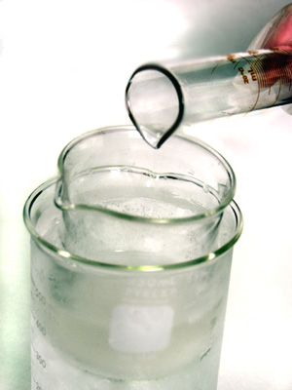
Synthesis
Source
Inorganic Synthesis Examples:
Synthesis of Coordination Compound
Synthesis of Alum from aluminum
Organic Synthesis Example:
Synthesis of Aspirin
Syntheses are done in solution, and require purification by filtration, recrystalization, column chromatography or a combination
% Yield is calculated; analysis is done by melting point, NMR, IR
Video
Virtual Lab
Synthesizing Alum Procedure:
Source of aluminum is reacted with KOH
Possible Error Sources: impurity in Al (such as plastic coating) prevents complete rxn
H₂SO₄ is added to ppt Al(OH)₃
Possible Error Sources: incomplete precipitation
Mixture heated until no Al(s) is left
Possible Error Sources: some Al(s) remains undissolved
Filter and collect alum crystals
Possible Error Sources: crystals escape to filtrate, crystals not washed well and remain wet
Recrystallize alum in ice bath
Possible Error Sources: crystals form too quickly, incomplete recrystallization
Science Practices
2.1 The student can justify the selection of a mathematical routine to solve problems.
2.2 The student can apply mathematical routines to quantities that describe natural phenomena.
4.2 The student can design a plan for collecting data to answer a particular scientific question.
6.1 The student can justify claims with evidence.
Learning Objectives
LO 3.5: The student is able to design a plan in order to collect data on the synthesis or decomposition of a compound to confirm the conservation of matter and the law of definite proportions.
LO 3.6: The student is able to use data from synthesis or decomposition of a compound to confirm the conservation of matter and the law of definite proportions.
LO:

Slide 7
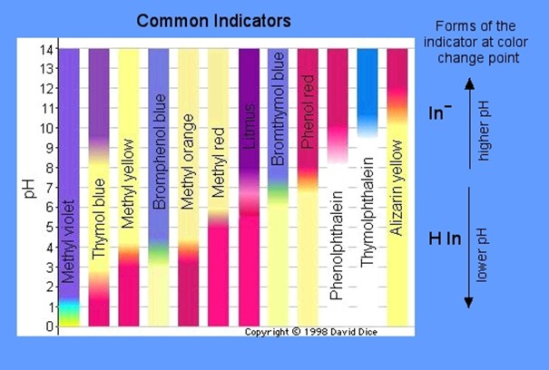
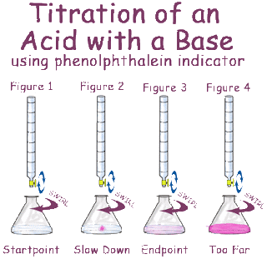
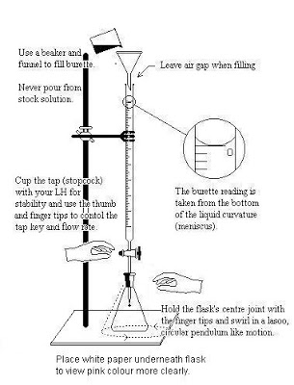
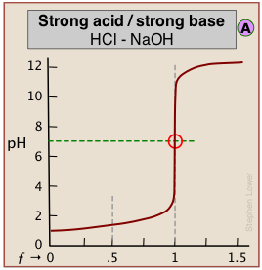
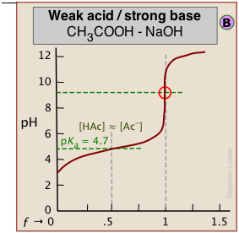
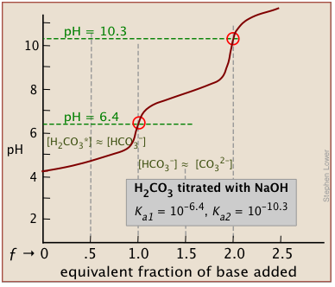
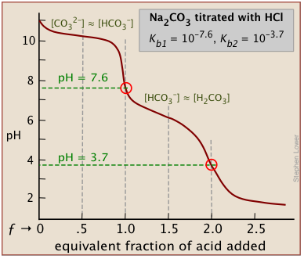
Titration- Acid/Base
Source 1
Assumption: Endpoint is equivalence point
This is not true – we actually “overshoot” before indicator changes
Possible Sources of Error:
Overshoot Endpoint
Moles of titrant (and therefore analyte) too high
Not reading to bottom of meniscus
Moles of titrant too low
Concentration of titrant not what expected
Be sure to rinse buret with titrant first to control for this
Source 2
Video
Source
Virtual Lab
Strength of Acids affects shape of graph:
Polyprotic acids have multiple end points:
Science Practices
1.4 The student can use representations and models to analyze situations or solve problems qualitatively and quantitatively.
5.1 The student can analyze data to identify patterns or relationships.
Learning Objectives
LO 6.12: The student can reason about the distinction between strong and weak acid solutions with similar values of pH, including the percent ionization of the acids, the concentrations needed to achieve the same pH, and the amount of base needed to reach the equivalence point in a titration.
LO 6.13: The student can interpret titration data for monoprotic or polyprotic acids involving titration of a weak or strong acid by a strong base (or a weak or strong base by a strong acid) to determine the concentration of the titrant and the pKa for a weak acid, or the pKb for a weak base.

Slide 8
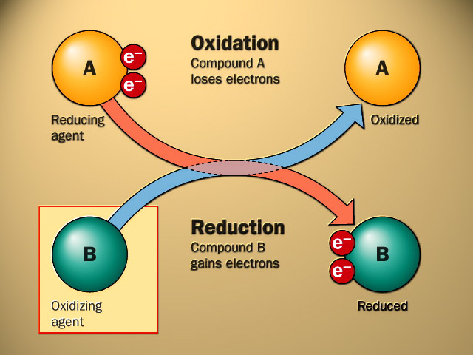
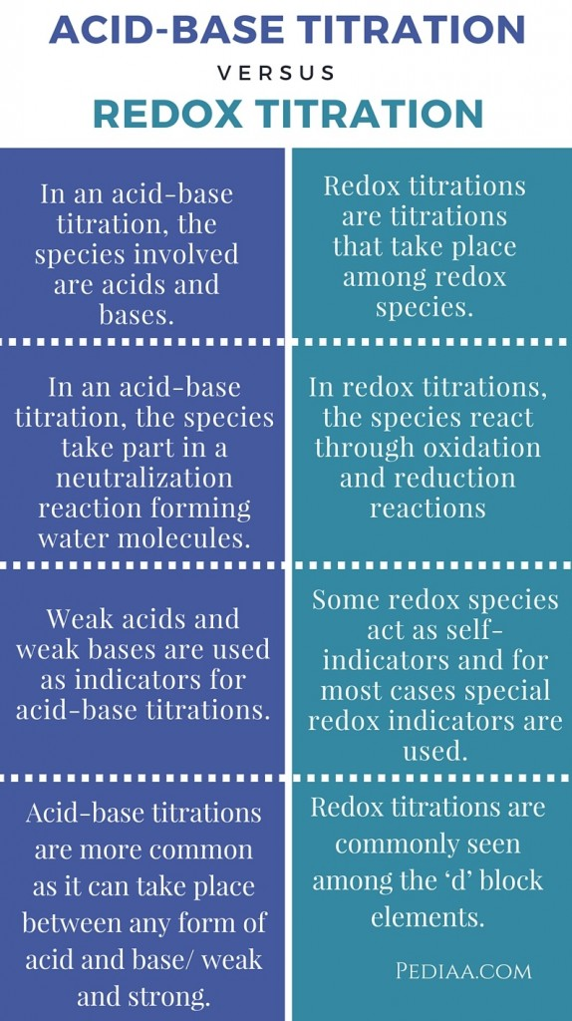
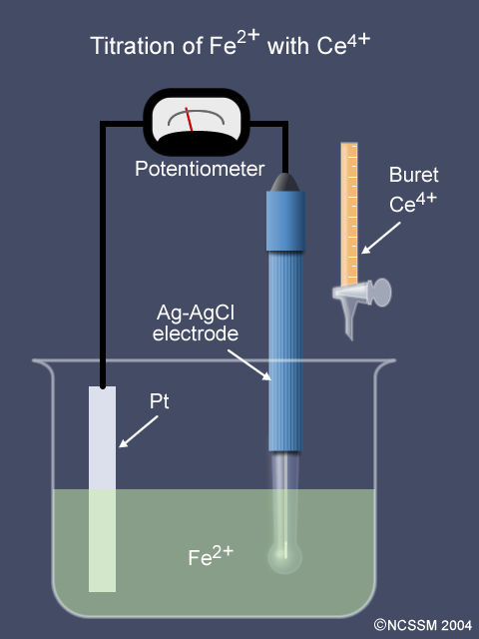
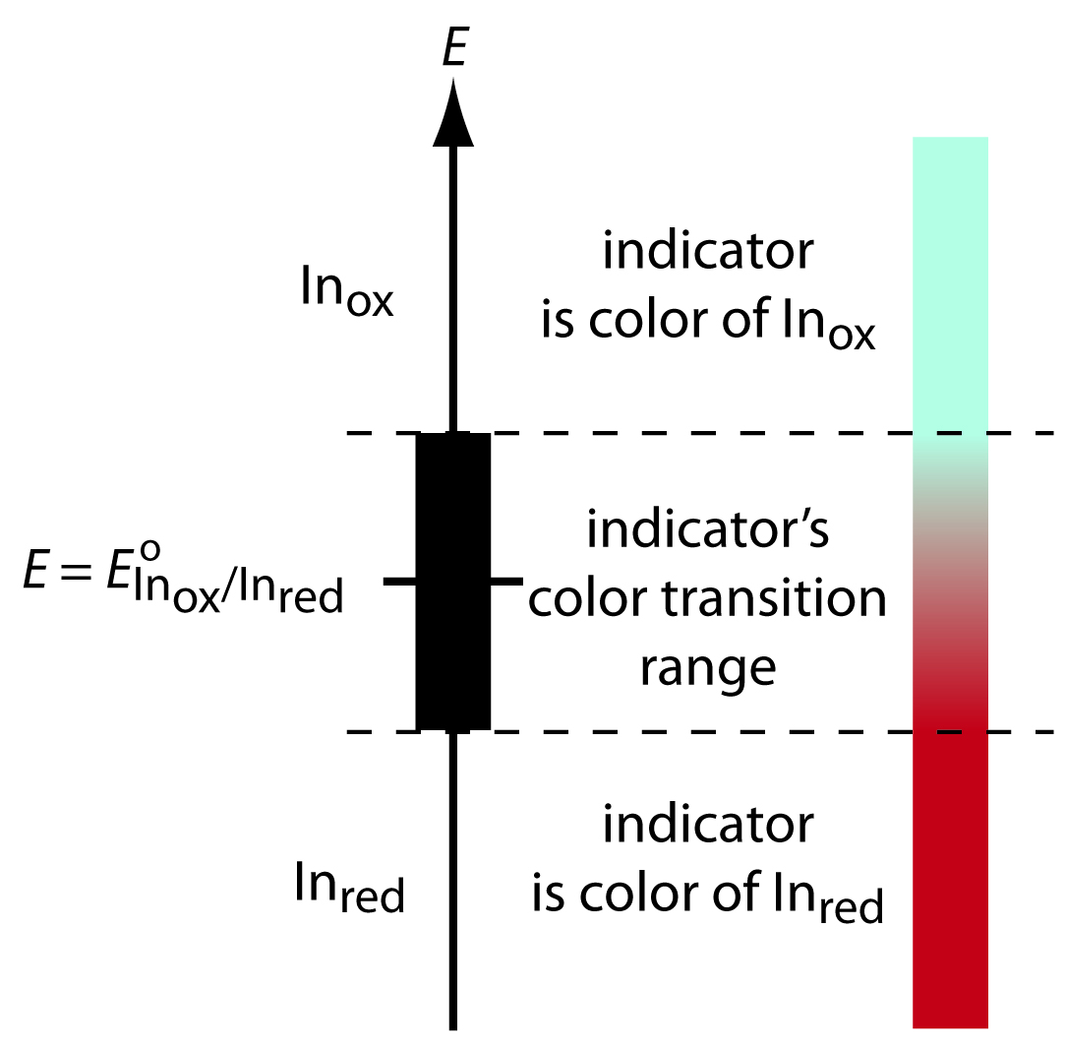
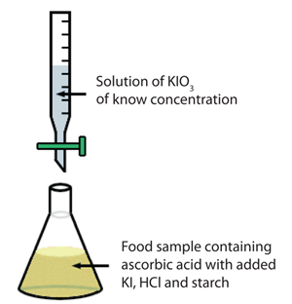
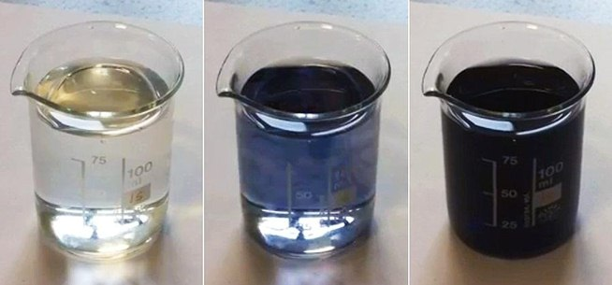
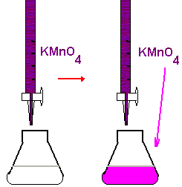
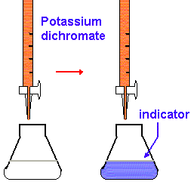
REDOX Titration
Source 1
Endpoint can be determined by potentiometer:
Or REDOX indicator:
Applications/Methods of REDOX Titrations:
Or an indicator that shows the presence of a particular species:
Vitamin C Content
Concentration of a redox species
Back Titrations
Video
Virtual Lab
Source
Starch indicates presence of iodine
Source
Source
Done when the endpoint can be hard to ID – add an excess, and then back titrate to determine how much is in excess
Science Practices
4.2 The student can design a plan for collecting data to answer a particular scientific question.
5.1 The student can analyze data to identify patterns or relationships.
Learning Objectives
LO 1.20: The student can design, and/or interpret data from, an experiment that uses titration to determine the concentration of an analyte in a solution.
LO 3.9: The student is able to design and/or interpret the results of an experiment involving a redox titration.

Slide 9
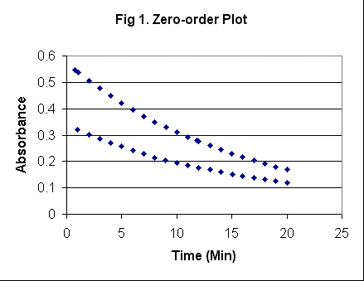
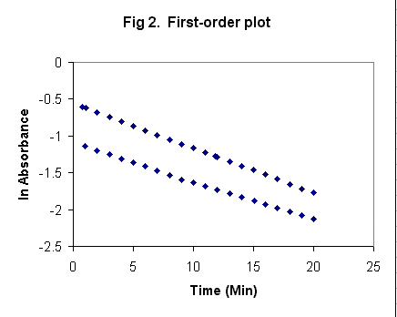
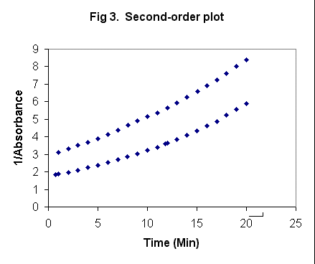
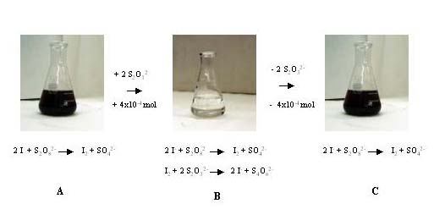
Kinetics
Virtual Lab 1
Virtual Lab 2
Video
Source 1
Using Spectrometry:
Data:
Analysis
rate law from straight-line graph
k from integrated rate law
E_{a} from Arrhenius Equation
Clock Reactions
Reactions that have a delayed physical change due to mechanism which only has a later step show color change
Concentration vs. time data can be gathered
It is important that there is a relatively low [S₂O₃⁻] so that the I₃⁻ will accumulate and show the color change
Time (s)
Zero Order Plot | 1st Order Plot | 2nd Order Plot
Blue in the presence of starch
Science Practices
2.1 The student can justify the selection of a mathematical routine to solve problems.
2.2 The student can apply mathematical routines to quantities that describe natural phenomena.
5.1 The student can analyze data to identify patterns or relationships.
Learning Objectives
LO 4.2: The student is able to analyze concentration vs. time data to determine the rate law for a zeroth-, first-, or second-order reaction.
LO 4.3: The student is able to connect the half-life of a reaction to the rate constant of a first-order reaction and justify the use of this relation in terms of the reaction being a first-order reaction.

Slide 10
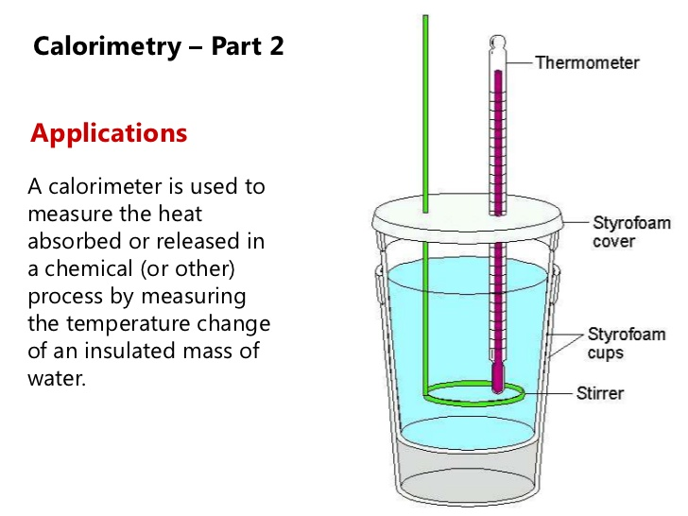
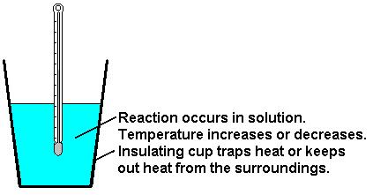
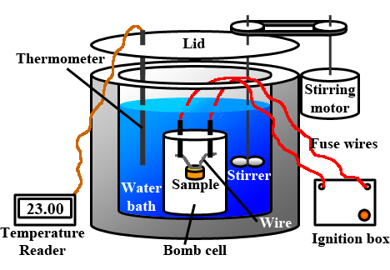
Calorimetry
Application of Law of Conservation of Energy: All heat produced/consumed during reaction (system) is exchanged with the surroundings.
Source 1
Applications:
Coffee Cup Calorimeter
Assumption:
the calorimeter is isolated
so the surroundings are only the calorimeter setup, which includes the water
the calorimeter itself has a heat capacity, as it will absorb some heat.
So…
q_{surr} = -q_{rxn}
q_{surr} = q_{cal}+q_{H2O+sys}
q_{cal} = CcalΔT
Therefore:
-q_{rxn}= C_{cal}ΔT + m_{H2O+sys}cΔT
Then we can use q_{rxn} find ΔH_{rxn}:
ΔH_{rxn} =q_{rxn}/mol_{react}
Specific Heat of Material
Can be used to ID unknown
Heat of reaction
Energy content of food
This is usually done in a bomb calorimeter (constant V)
Video
Virtual Lab
Constant P
Source
Source
Science Practices
1.4 The student can use representations and models to analyze situations or solve problems qualitatively and quantitatively.
2.2 The student can apply mathematical routines to quantities that describe natural phenomena.
4.2 The student can design a plan for collecting data to answer a particular scientific question.
5.1 The student can analyze data to identify patterns or relationships.
Learning Objectives
LO 5.4: The student is able to use conservation of energy to relate the magnitudes of the energy changes occurring in two or more interacting systems, including identification of the systems, the type (heat versus work), or the direction of energy flow.
LO 5.7: The student is able to design and/or interpret the results of an experiment in which calorimetry is used to determine the change in enthalpy of a chemical process (heating/cooling, phase transition, or chemical reaction) at constant pressure.

Slide 11
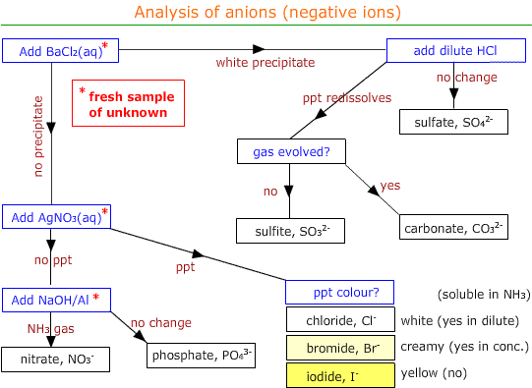
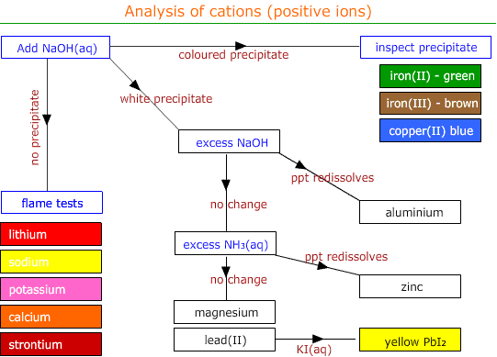
Qualitative Analysis
Virtual Lab 1
Virtual Lab 2
Video
Source
Remember that the lower the K_{sp}, the less soluble the substance. Qualitative analysis then also allows a ranking of salts by K_{sp}, and demonstrates the effect of pH on solubility.
Science Practices
2.2 The student can apply mathematical routines to quantities that describe natural phenomena.
2.3 The student can estimate numerically quantities that describe natural phenomena.
5.1 The student can analyze data to identify patterns or relationships.
6.4 The student can make claims and predictions about natural phenomena based on scientific theories and models.
Learning Objectives
LO 6.21: The student can predict the solubility of a salt, or rank the solubility of salts, given the relevant Ksp values.
LO 6.22: The student can interpret data regarding solubility of salts to determine, or rank, the relevant Ksp values.
LO 6.23: The student can interpret data regarding the relative solubility of salts in terms of factors (common ions, pH) that influence the solubility.

Slide 12
Now…
Just for Fun:
Some “Harry” Problems

Slide 13
2Fe(OH)₃ (s) + 3H₂SO₄ (aq) à Fe₂(SO₄)₃ (aq) + 6H₂O (l)
a. Ron Weasley had to perform the above reaction in Professor Snape’s potions class. Ron mixed 45.0 g iron III hydroxide with 45.0 ml 2.00 M sulfuric acid in a cauldron, leaving the lid off. The heat capacity of his cauldron was 645 J/K.
i. What other information would Ron need to know or measure experimentally to determine the molar change in enthalpy of the reaction, ∆H°rxn?
ii. Unbeknownst to Ron, Draco Malfoy dropped a 100 g sneakoscope (assume this is unreactive and at room temperature) into Ron’s cauldron before Ron measured his temperature but after the reaction was initiated. Explain in which direction this would alter Ron’s experimental value of ∆H°rxn.
b. Hermione Granger also performed this reaction. She mixed 45.0 g iron III hydroxide with 450 ml 2.00 M sulfuric acid in her cauldron, and kept the lid on, using a spell to enable her to measure temperature (revelio thermo).
i. How would you expect her temperature change to differ from Ron’s, if at all? For this comparison, assume that Ron’s reaction was performed with the lid on and with no sneakoscope.
ii. Hermione repeated the experiment using all the same measurements, but used aluminum hydroxide instead of iron III hydroxide. Assuming that both reactions have the same ∆H°rxn, would her temperature change be smaller, the same, or greater in her second experiment.
c. Given the following values for absolute entropies, what would ∆S°rxn be?

Slide 14
Just for Fun… Answers
ai. q_{rxn} = -(C_{cal}∆T + c_{(mixture)}m_{(mixture)}∆T); ∆H°rxn = q_{rxn} / moles rxn
Ron would need to measure the starting and final temperatures, know (or measure) the specific heat capacity and mass of the reaction mixture, and the number of moles of reaction. In this case,
45.0 g Fe(OH)₃ / 106.8 g/mole = 0.421 moles; 0.045 L x 2 M = 0.09 moles H₂SO₄ (limiting), so 0.03 moles reaction (to those who dislike this concept, I apologize).
bii. 45.0 g Al(OH)₃ / 78 g/mole = 0.577 mole. This is still limiting, but now there are about 0.288 moles of reaction, so more heat is produced. As the total mass doesn’t change, and the specific heat capacity is unlikely to change dramatically, it is reasonable to predict that ∆T would be larger.
aii. Because the sneakoscope would absorb heat, ∆T would be lower, so the heat of the reaction would appear to be lower as would ∆H°rxn.
c. ∆S°rxn = sum product S° - sum reactant S°
∆S°rxn = 6(69.91) + 2(-315.9) + 3(20.1) – 2(107) – 3(20.08) = -426.3 J/mole*K.
bi. For Hermione, the Fe(OH)₃ is now limiting, as there are now 0.9 moles H₂SO₄. So, there are more moles of reaction, about 0.21, a seven-fold increase. This would increase the temperature change. However, there is also a significant increase in mass of the reaction mixture, from about 90 g to 500 g. This would decrease the temperature change. So the exact ∆T outcome, increase or decrease, depends on the specific heat capacity of the reaction mixture.

