Slide 1
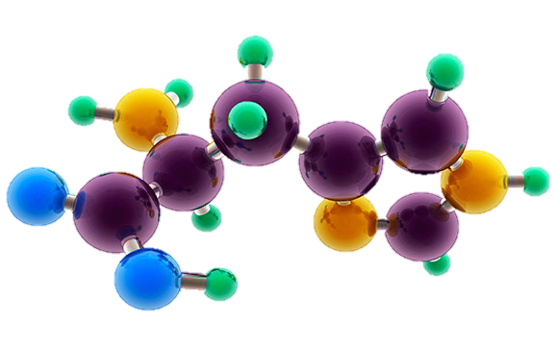
AP Chemistry Exam Review

Slide 2
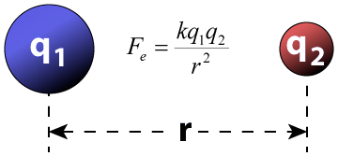
Big Idea #1
Properties of Matter

Slide 3
Composition of Pure Substances and/or Mixtures
Source
Percent mass can be used to determine the composition of a substance
% mass can also be used to find the empirical formula
The empirical formula is the simplest formula of a substance
It is a ratio between the moles of each element in the substance
Quick steps to solve!
% to mass, mass to moles, divide by the smallest and multiply ‘til whole!)
The molecular formula is the actual formula of a substance
It is a whole number multiple of the empirical formula
Video
Click reveals answer and explanation.
LO 1.2: Select and apply mathematical routines to mass data to identify or infer the composition of pure substances and/or mixtures.

Slide 4
Identifying Purity of a Substance
Source
Impurities in a substance can change the percent composition by mass
If more of a certain element is added from an impurity, then the percent mass of that element will increase and vice versa
When heating a hydrate, the substance is heated several times to ensure the water is driven off
Then you are simply left with the pure substance and no excess water
Video
The mass percent of oxygen in pure glucose, C₆H₁₂O₆ is 53.3 percent. A chemist analyzes a sample of glucose that contains impurities and determines that the mass percent of oxygen is 49.7 percent. Which of the follow impurities could account for the low mass percent of oxygen in the sample?
n-eicosane (C₂₀H₄₂)
ribose C₅H₁₀O₅
fructose, C₆H₁₂O₆
sucrose C₁₂H₂₂O₁₁
a. Is the only option with a %O lower than 49.7%
LO 1.3: The student is able to select and apply mathematical relationships to mass data in order to justify a claim regarding the identity and/or estimated purity of a substance.

Slide 5
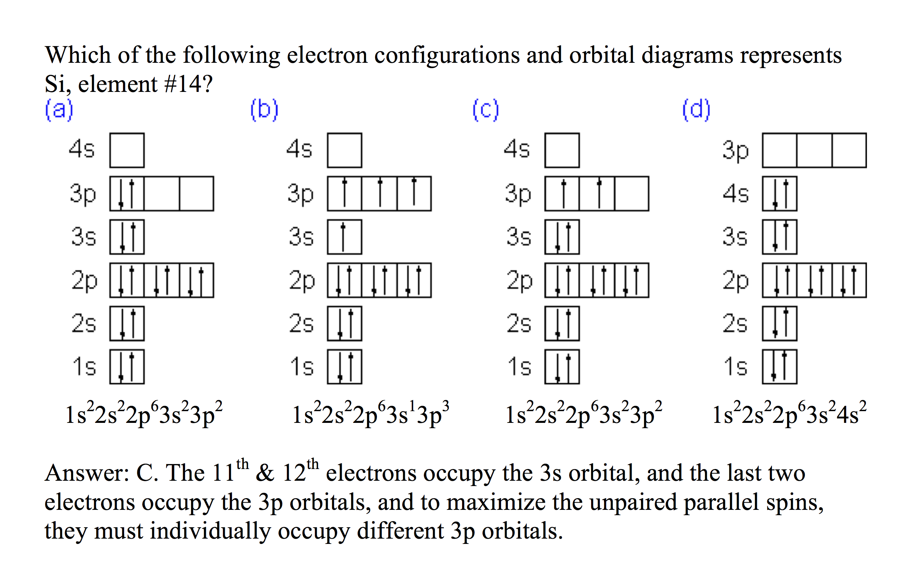
Electronic Structure of the Atom: Electron Configurations
Source
Electrons in occupy orbitals whose energy level depends on the nuclear charge and average distance to the nucleus
Electron configurations & orbital diagrams indicate the arrangement of electrons with the lowest energy (most stable):
Electrons occupy lowest available energy levels
A maximum of two electrons may occupy an energy level
Each must have opposite spin (±½)
In orbitals of equal energy, electrons maximize parallel unpaired spins
Video
Click reveals answer and explanation.
LO 1.5: The student is able to explain the distribution of electrons in an atom or ion based upon data.

Slide 6
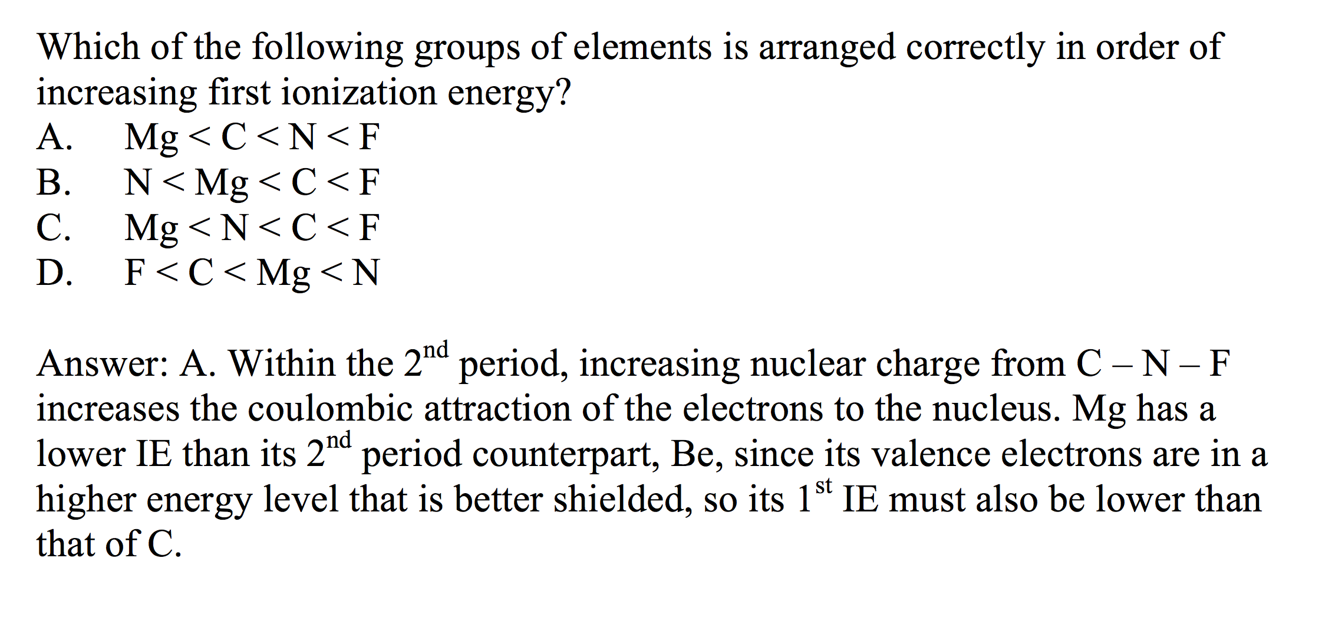
Electronic Structure of the Atom: 1st Ionization Energy
Source
1st Ionization Energy Energy (IE) indicates the strength of the coulombic attraction of the outermost, easiest to remove, electron to the nucleus:
X(g) + IE X⁺(g) + e–
1st IE generally increases across a period and decreases down a group
IE generally increases as #protons increases in same energy level
IE decreases as e– in higher energy level: increased shielding, e– farther from nucleus
Video
Click reveals answer and explanation.
LO 1.6: The student is able to analyze data relating to electron energies for patterns and relationships.

