Slide 2
Chemical Reactivity
Source
Using Trends
Nonmetals have higher electronegativities than metals --> causes the formation of ionic solids
Compounds formed between nonmetals are molecular
Usually gases, liquids, or volatile solids at room temperature
Elements in the 3rd period and below can accommodate a larger number of bonds
The first element in a group (upper most element of a group) forms pi bonds more easily (most significant in 2nd row, non-metals)
Accounts for stronger bonds in molecules containing these elements
Major factor in determining the structures of compounds formed from these elements
Elements in periods 3-6 tend to form only single bonds
Reactivity tends to increase as you go down a group for metals and up a group for non-metals.
46) Of the elements below, __________ is the most chemically reactive.
A) sodium
B) barium
C) calcium
D) cesium
E) magnesium
Video
L.O. 1.10: Students can justify with evidence the arrangement of the periodic table and can apply periodic properties to chemical reactivity

Slide 3
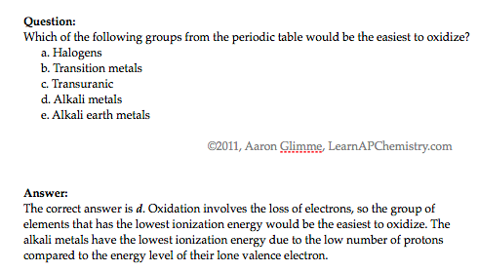
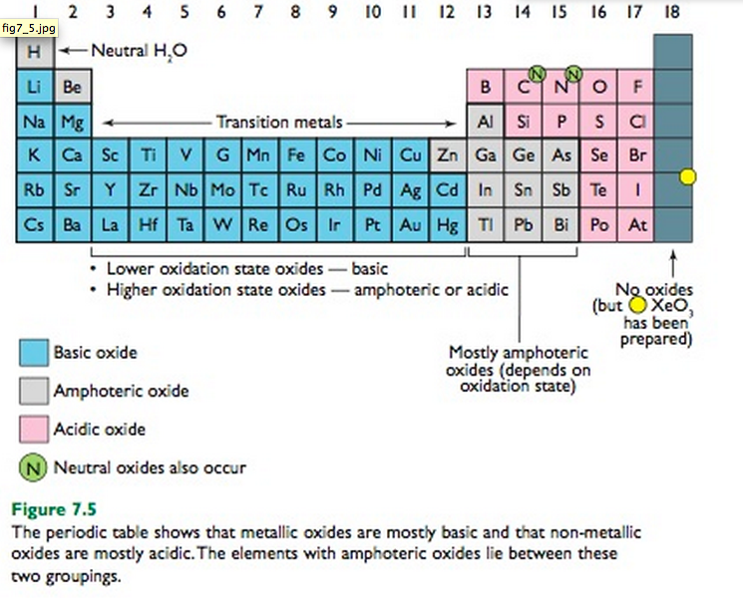
Chemical Properties within a Group and across a Period
Source
Group 1 metals more
reactive than group 2
metals
Reactivity increases as you go down a group
Metals on left form basic oxides
Ex. Na₂O + H₂O → 2 NaOH
Nonmetals on right form form acidic oxides
Ex. SO₃ + H₂O → H₂SO₄
Elements in the middle, like Al, Ga, etc can behave amphoterically
If SiO₂ can be a ceramic then SnO₂ may be as well since both in the same group
Video
Click reveals answer and explanation.
its
attracts
LO 1.11: Analyze data, based on periodicity & properties of binary compounds, to identify patterns & generate hypotheses related to molecular design of compounds

Slide 4
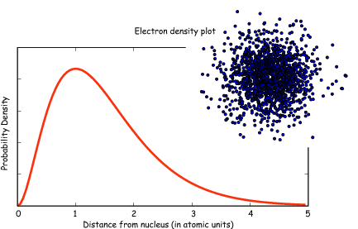
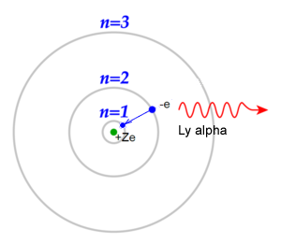
Classic Shell Model of Atom vs
Quantum Mechanical Model
Source
Quantum Mechanical Model
Developed by Schrodinger and the position of an electron is now
represented by a wave equation
Most probable place of finding an electron is called an ORBITAL (90% probability)
Each orbital can only hold 2 electrons with opposing spins (S, P, D & F orbitals)
Evidence for this theory:
Work of DeBroglie and PLanck that electron had wavelike characteristics
Heisenberg Uncertainty Principle - impossible to predict exact location of electron- contradicted Bohr
This new evidence caused the Shell Theory to be replaced by the Quantum Mechanical Model of the atom
Shell Model - Bohr
Developed by Schrodinger and the position of an electron is now
represented by a wave equation
Most probable place of finding an electron is called an ORBITAL (90% probability)
Each orbital can only hold 2 electrons with opposing spins (S, P, D & F orbitals)
Evidence for this theory:
Work of DeBroglie and PLanck that electron had wavelike characteristics
Heisenberg Uncertainty Principle - impossible to predict exact location of electron- contradicted Bohr
This new evidence caused the Shell Theory to be replaced by the Quantum Mechanical Model of the atom
Video
LO 1.12: Explain why data suggests (or not) the need to refine a model from a classical shell model with the quantum mechanical model

Slide 5
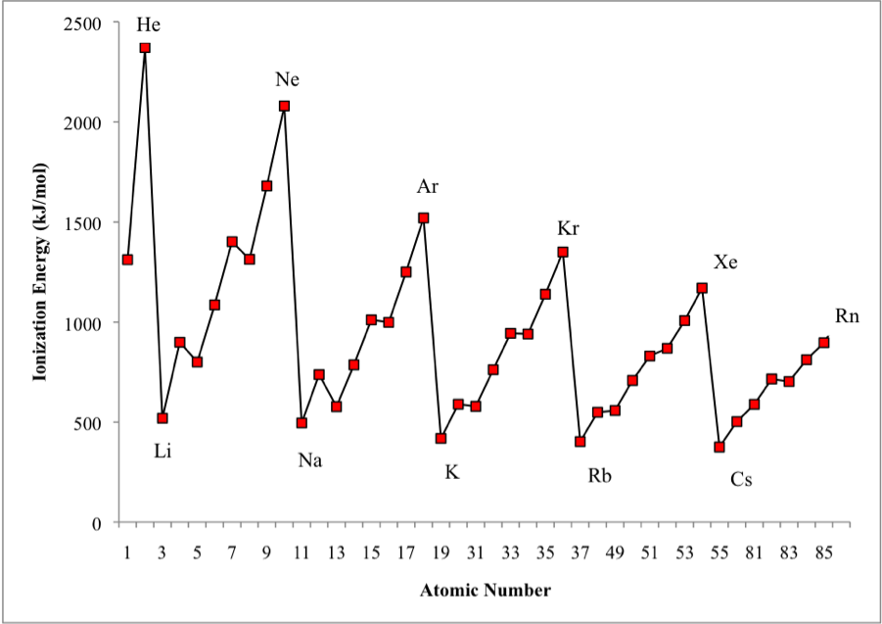
Shell Model is consistent with Ionization Energy Data
Source
The patterns shown by
the IE graph can be
explained by Coulomb’s law
As atomic number increases, would expect the ionization energy to constantly increase
Graph shows that this is NOT observed. WHY NOT?
The data implies that a shell becomes full at the end of each period
Therefore the next electron added must be in a new shell farther away from the nucleus.
This is supported by the fact that the ionization energy drops despite the addition positive charge in the nucleus
Video
LO: 1.13 Given information about a particular model of the atom, the student is able to determine if the model is consistent with specified evidence

Slide 6
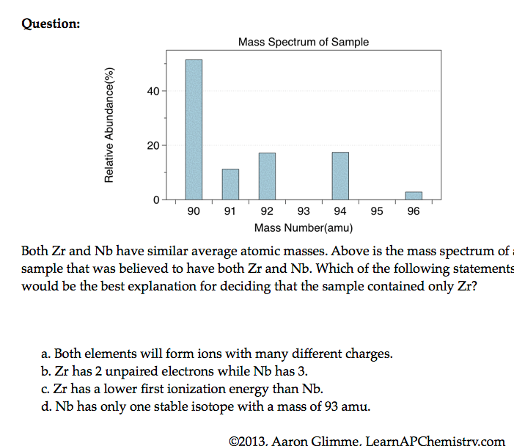
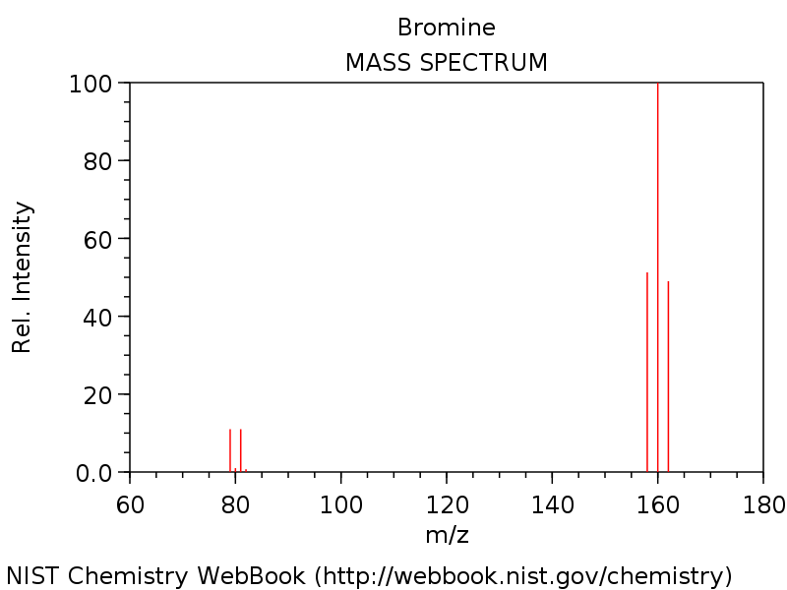
Mass Spectrometry - evidence for isotopes
Source
Mass spectrometry showed
that elements have isotopes
This contradicted Dalton’s early model of the atom which stated that all atoms of an element are identical
3 Br₂ & two Br isotopes shown in diagram
The average atomic mass of the element can be estimated from mass spectroscopy
Video
LO 1.14: The student is able to use the data from mass spectrometry to identify the elements and the masses of individual atoms of a specific element

Slide 7
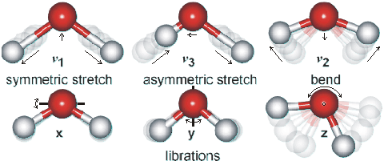
Using Spectroscopy to measure properties associated with vibrational or electronic motions of molecules
Source
IR Video
UV Video
IR Radiation - detects different types of bonds by analyzing molecular vibrations
UV or X-Ray Radiation
Photoelectron Spectroscopy(PES)
Causes electron transitions
Transitions provides info on
electron configurations
LO: 1.15 Justify the selection of a particular type of spectroscopy to measure properties associated with vibrational or electronic motions of molecules

Slide 8
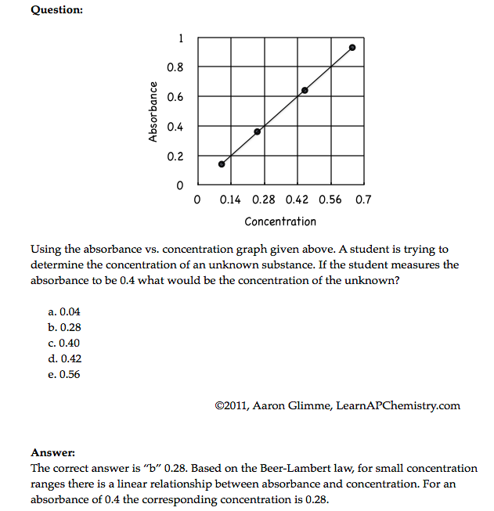
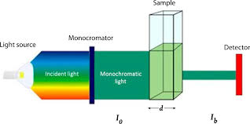
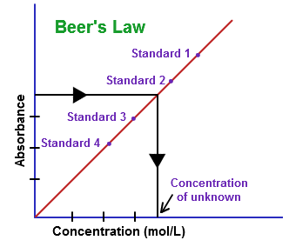
Beer-Lambert Law - used to measure the concentration of colored solutions
Source 1, 2
Video
A = abc
A = absorbance
a = molar absorptivity (constant for material being tested)
b = path length (cuvette = 1 cm)
c = concentration
Taken at fixed wavelength
Click reveals answer and explanation.
LO1.16: Design and/or interpret the results of an experiment regarding the absorption of light to determine the concentration of an absorbing species in solution

Slide 9
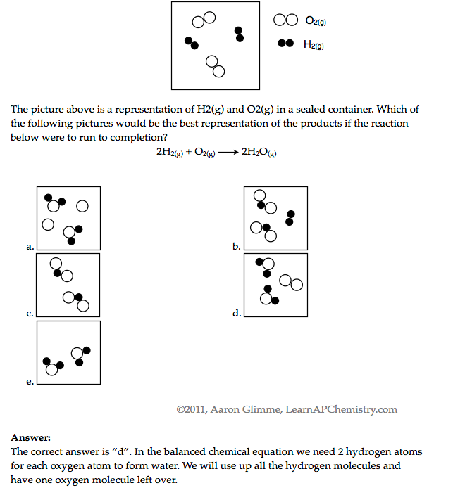
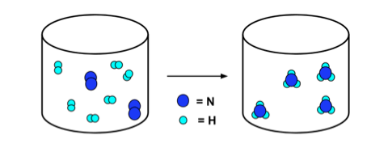
Law of Conservation of Mass
Source
Video
N₂ + 3H₂ → 2NH₃
Click reveals answer and explanation.
LO1.17: Express the law of conservation of mass quantitatively and qualitatively using symbolic representations and particulate drawings

Slide 10
Use Mole Ratio in balanced equation to calculate moles of unknown substance
Source
Video
LO1.18: Apply the conservation of atoms to the rearrangement of atoms in various processes.

Slide 11
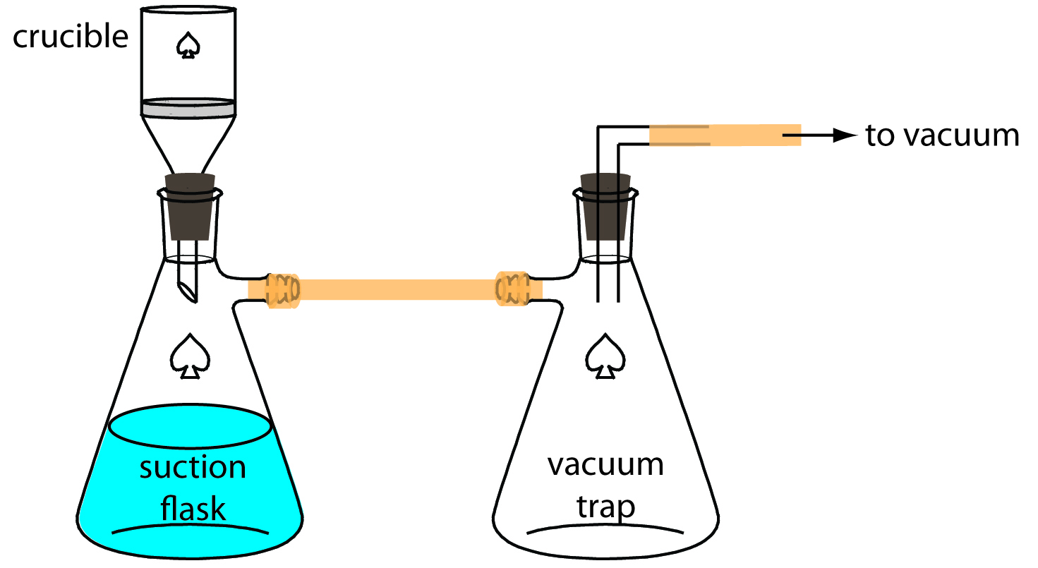
Gravimetric Analysis
Source
Buchner Filtration Apparatus
Video
How much lead
(Pb²⁺) in water?
Pb²⁺(aq) + 2Cl⁻(aq) → PbCl₂ (s)
By adding excess Cl- to the sample, all of the Pb²⁺ will precipitate as PbCl₂
Solid product is filtered using a Buchner Filter and then dried to remove all water
Mass of PbCl₂is then determined
This can be used to calculate the original amount of lead in the water
LO 1.19: Design and/or interpret data from, an experiment that uses gravimetric analysis to determine the the concentration of an analyte in a solution.

Slide 12
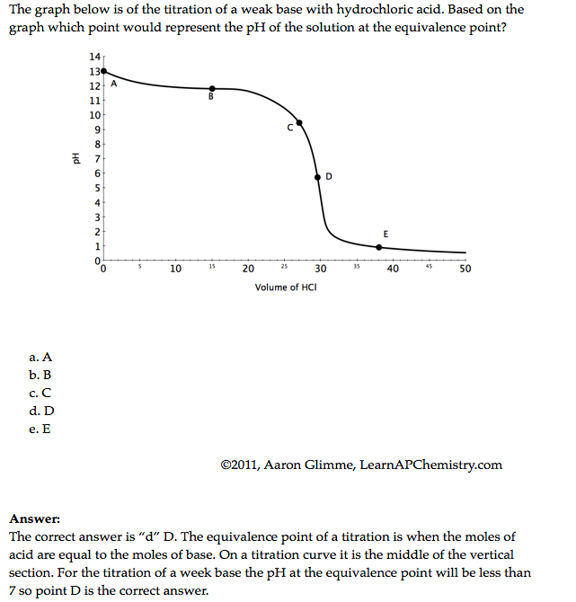
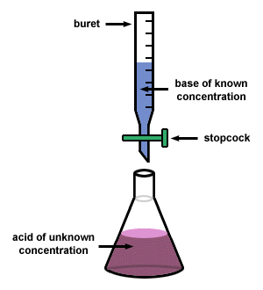
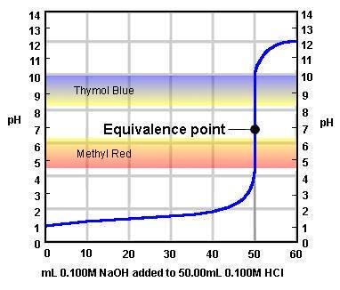
Using titrations to determine concentration of an analyte
Source
Video
At the equivalence point, the stoichiometric molar ratio is reached
Click reveals answer and explanation.
LO1.20: Design and/or interpret data from an experiment that uses titration to determine the concentration of an analyte in a solution.

